Slide 1
Commercial Buildings Energy Assessment Program
Training Module 1.1
Introduction to Commercial Building Energy Auditing

Slide 2
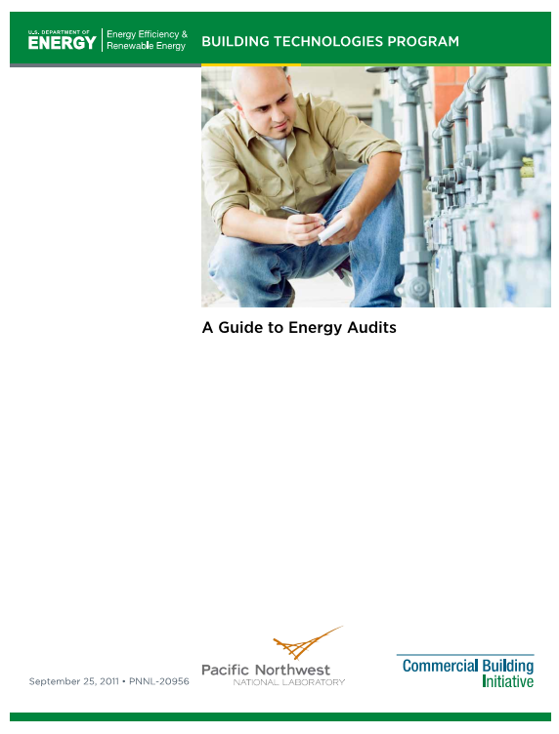
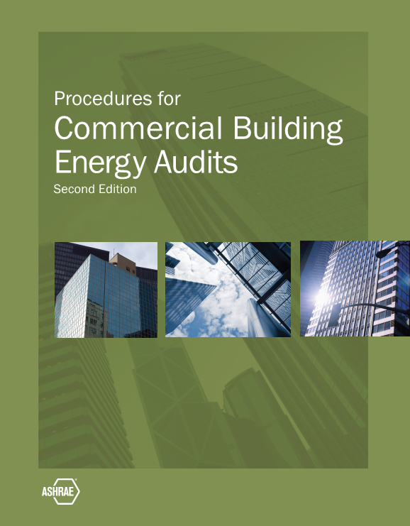
What is a Commercial Building Energy Audit?

Slide 3
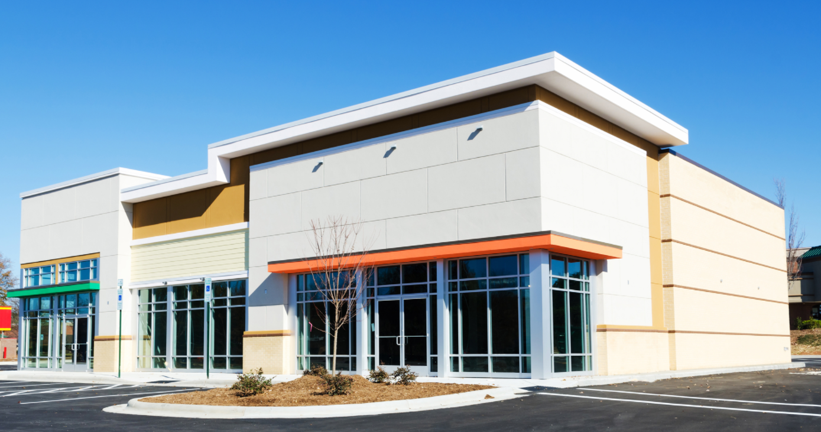
Commercial Buildings

Slide 4
Terminology
Energy Audit
Energy Assessment
Energy Analysis
Energy Survey
Energy Evaluation

Slide 5
Levels of Effort
Level 1 Walk-Through Analysis
Level 2 Energy Survey Analysis
Level 3 Detailed Analysis of Capital Intense Modifications
“Targeted Audits”

Slide 6
Preliminary Energy Use Analysis
ECI Energy Cost Index ($/square foot/year)
EUI Energy Utilization Index (kBtu/square foot/year)

Slide 7
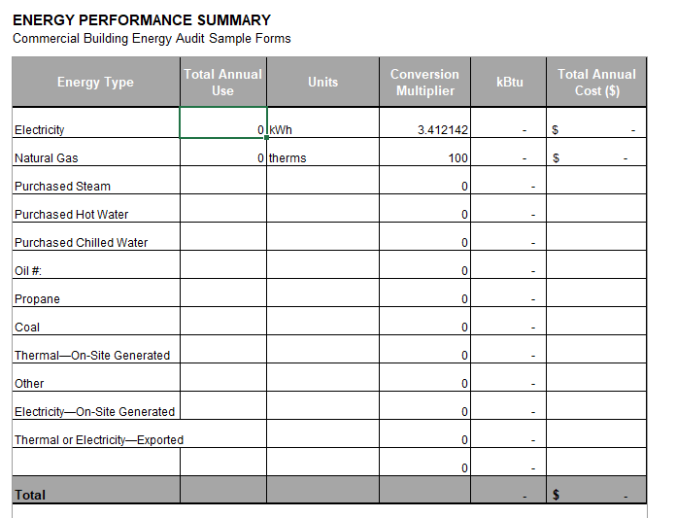
Level 1 – Walk Through Survey
Establish energy savings potential
Prioritize measures for Level 2 and
Level 3 analysis

Slide 8
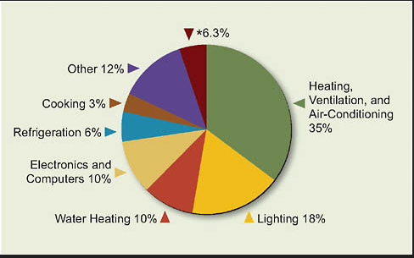
Level 2 – Energy Survey and Analysis
Energy End Use
EEMs Energy Efficiency Measures
O&M Operation and Maintenance
Procesures

Slide 9
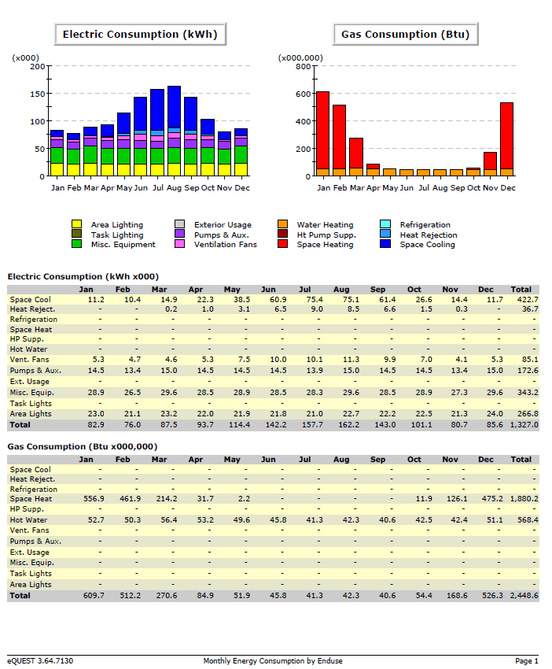
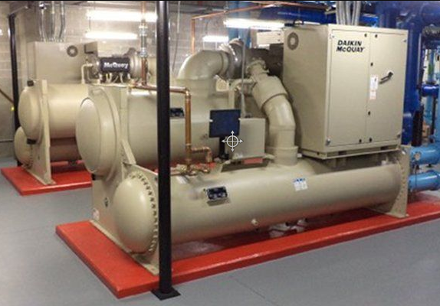
Level 3 – Detailed Analysis of Capital-Intense Modifications
Energy Modeling
Life Cycle Cost Analysis

Slide 10
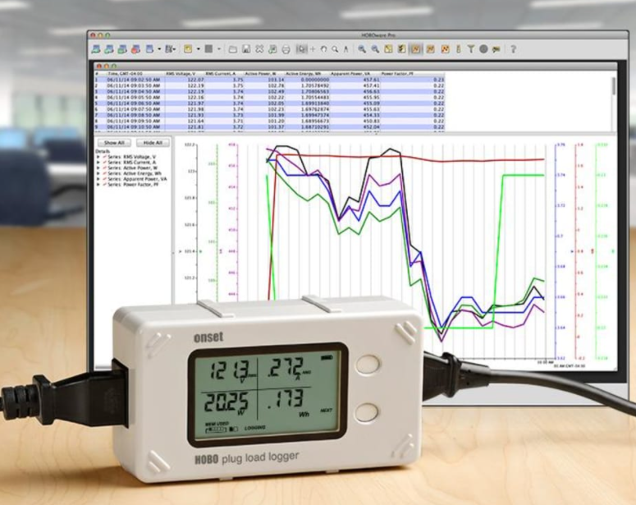
Targeted Audits
Data logging
Trend data

Slide 11
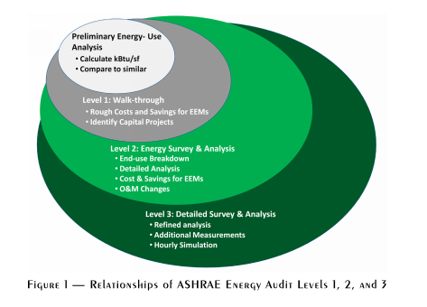
Conclusion
ASHRAE Procedures for Energy Audits, Figure 1 page 7

