Slide 1
Commercial Buildings Energy Assessment Program
Training Module 1.2
EUI
What is it? How to Calculate EUI

Slide 2
What is EUI?
EUI
Energy Utilization Index
or
Energy Use Intensity
kBtu/SF/yr

Slide 3
Building Energy Sources
Electricity
Natural Gas
Fuel Oil
LPG
Wood
Coal

Slide 4
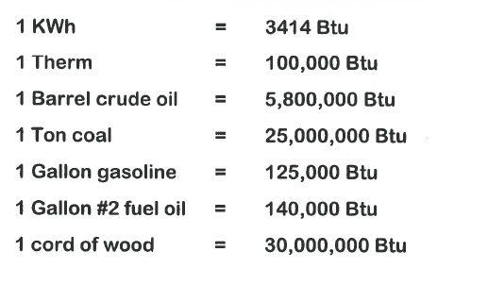
Units of Measure
Electricity – kilowatt (kW) and kilowatt-hr (kWh)
Note: kW measure demand (power); kWh measures energy consumed; Review Training Module 2.2 on Work, Power and Energy
Natural Gas – Cubic feet and Therms (100,000 Btu = 1 Therm)
Fuel Oil – Gallons
LPG - Gallons

Slide 5
BTU
British Thermal Unit
1 Btu = Heat required to raise the temperature of 1 lb of water by 1 deg F
1 kBtu = 1,000 Btu
The Btu is a common thermal unit used in building energy analysis

Slide 6
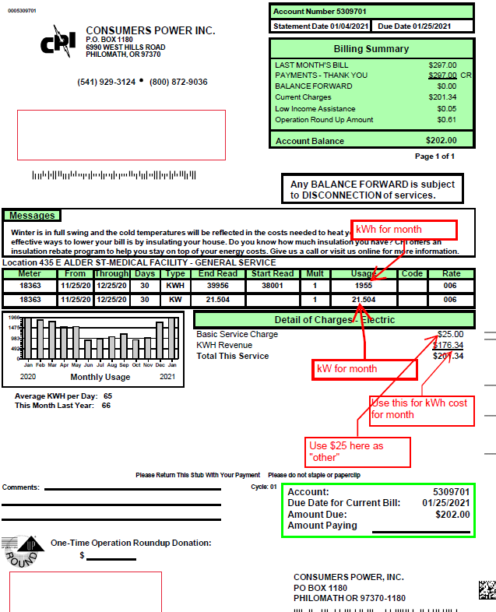
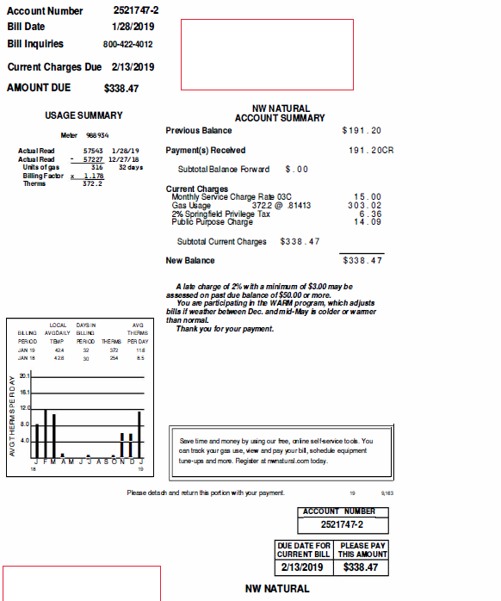
Calculating Energy Use
Building Energy Use Data
Utility Bills
Training Module 1.4
Utility Data Analysis

Slide 7
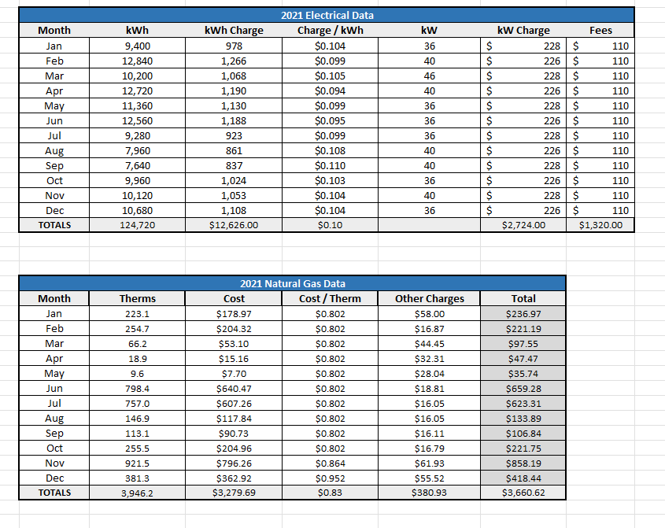
Calculating Energy Use
Building Energy Use Data
Utility Bills

Slide 8
Calculating Energy Use
Building Energy Use Data
Convert Energy Use to kBtu for all Fuel Types
1 kWh = 3413 Btu
1 Therm = 100,000 Btu
Example:
A building has an annual electrical consumption of 523,700 kWh/year and a natural gas consumption of 5,500 Therms.
Determine the energy use for electricity and therms in units of kBtu.
Calculate the total building energy use in kBtu

Slide 9
Calculating Energy Use
1 kWh = 3413 Btu
1 Therm = 100,000 Btu
Example:
A building has an annual electrical consumption of 523,700 kWh/year and a natural gas consumption of 5,500 Therms.
Determine the energy use for electricity and therms in units of kBtu.
Calculate the total building energy use in kBtu
Electrical Use
(523,700 kWh x 3413 Btu/kWh) ÷ 1,000 kBtu/Btu = 1,787,388 kBtu
Natural Gas Use
5,500 Therms x 100,000 Btu/Therm ÷ 1,000 kBtu/Btu = 550,000 kBtu
Total Building Energy Use = 2,337,388 kBtu

Slide 10
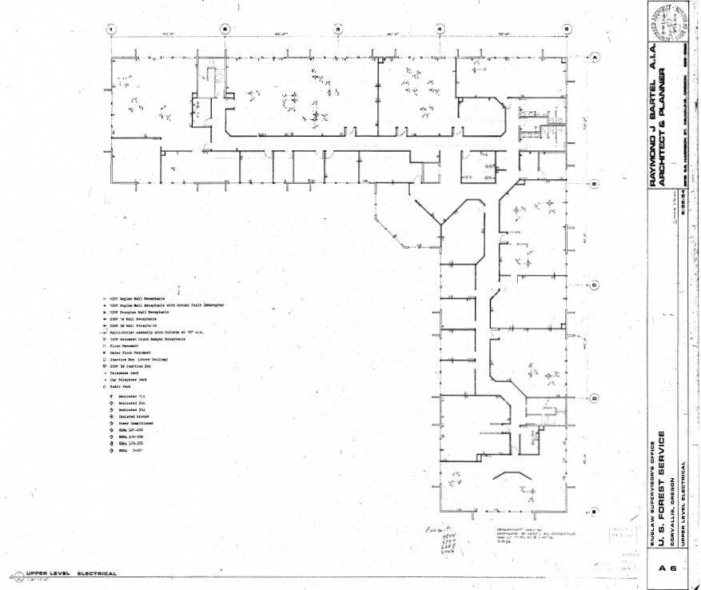
Calculating EUI
Total Building Area = 30,000 Square Ft
EUI = 2,337,388 kBtu ÷ 30,000 sq/ft = 78 kBtu/sf

Slide 11
Benchmarking
Total Building Area = 30,000 Square Ft
EUI = 2,337,388 kBtu ÷ 30,000 sq/ft = 78 kBtu/sf
Training Module 1.5 Benchmarking

