Slide 1
Commercial Buildings Energy Assessment Program
Training Module 1.0
Introduction to US Dept of Energy-Oregon State University and Lane Community College
CBEA Program

Slide 2
IAC Background

Slide 3
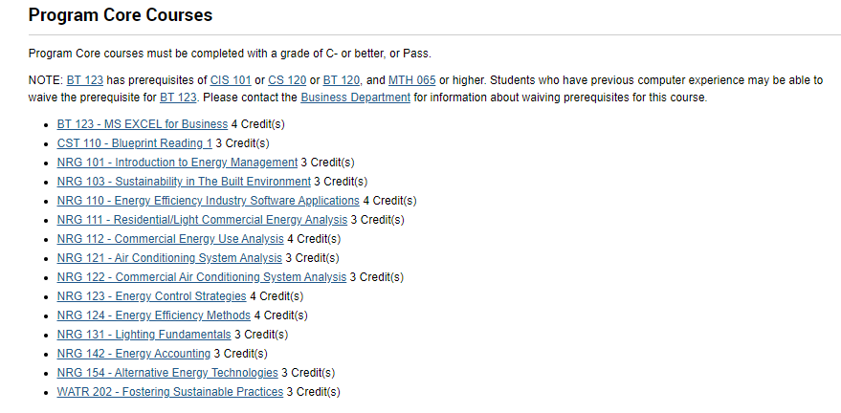
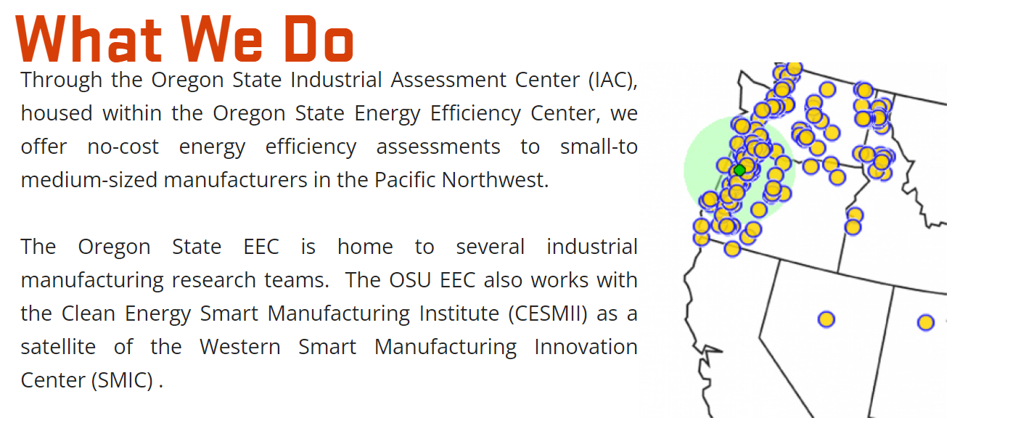
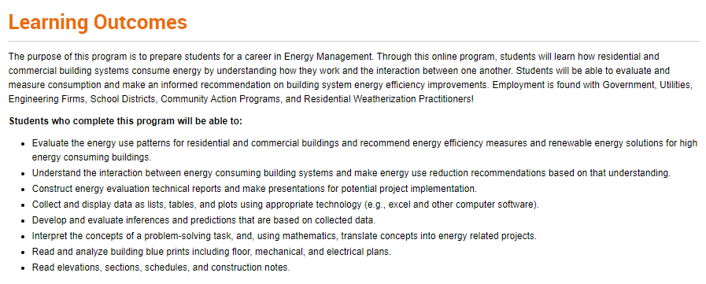
CBEA Program
TOPIC 1
OSU Industrial Assessment Center
Energy Management Program
TOPIC 2

Slide 4
CBEA Program
TOPIC 2: Commercial Buildings Energy Assessments
Pilot Program
Goals:
Expand the workforce of building efficiency professionals.
Launch a pilot program and create opportunities for more diverse applicants.
Partner with building efficiency students from community colleges and technical programs
Train students in conducting assessments of existing small to medium commercial buildings (under 100,000 sq. ft)
Include facilities located in disadvantaged communities

