Slide 1
Activating Your Schema
Notes:
‹#›
This presentation is designed for students in grades 4-6. It will help them to understand how they need to use their background knowledge (schema) to make inferences. For more on helping students to make inferences, look at The Forest AND the Trees: Helping Students to Identify Important Details in Texts and Tests by Emily Kissner.

Slide 2
Essential Questions
Why is it important to activate my schema before I begin to read?
How can my schema help me to understand unfamiliar text?
Notes:
‹#›

Slide 3
Activating Your Schema
Your schema is what you already know about a topic
Think about a schema as a file folder in your mind
Notes:
‹#›
Don’t be afraid to use the term “schema” with your students—they will be able to understand it! This term will help you to develop a common language for talking about what they already know.

Slide 4
Activating Your Schema
When you start to read a text, you need to open up the file folder about the topic
This is called “activating your schema”
Notes:
‹#›

Slide 5
Activate Your Schema!
Suppose that you are about to read a text about skiing
To activate your schema, think: What do I already know about this topic?
Notes:
‹#›
Of course, your students may have different kinds of knowledge about skiing. Talk about this! Has anyone been skiing? They probably know more about skiing than those students who have never been. Even if you live in an area where students cannot go skiing, you will find that they probably know quite a bit from watching television.

Slide 6
Activate Your Schema!
What you already know about skiing will help you as you read the text
For example, you probably know these things:
Skiing happens outside
There is snow
Most people ski on hills
Notes:
‹#›

Slide 7
Using Your Schema
Because you have a schema for skiing, you know what is and is not expected in the text
Will there be…
People falling?
Palm trees?
Seagulls?
Hot chocolate?
Notes:
‹#›
If your students have reading response journals, you may want to have them write “Yes” or “No” for each of these items.

Slide 8
Using Your Schema
Suppose you read the text below:
Lea picked up her equipment bag. She was excited to be headed to the slopes!
Notes:
‹#›

Slide 9
Using Your Schema
Lea picked up her equipment bag. She was excited to be headed to the slopes!
Even though it is not in the text, you probably know what is in the bag!
You are using your schema to make this inference
Notes:
‹#›

Slide 10
Use your schema for this one:
Think about your schema for skiing once again
What clues can you pick up from this text?
The ambulance’s siren blared as it raced to the slopes.
Notes:
‹#›

Slide 11
What about harder text?
Using your schema is even more important with harder text!
At Snowy Peaks Slopes, the staff doesn’t care if it snows or not. They know that they can outsmart the weather.

Slide 12
Activate you schema!
What do you know about ski resorts?
You may know that ski slopes have huge snowmaking machines
The staff probably outsmarts the weather by making snow!

Slide 13
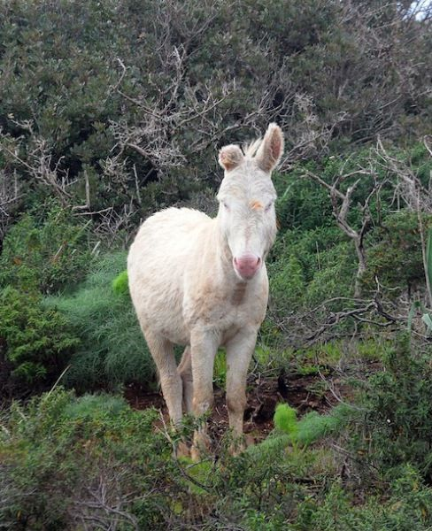
Is this easier?
The herdsman came out from the firs and saw a burro coming down from the butte.
*Do you think someone from Hawaii would have an easy time with this sentence?

Slide 14
Another example
Suppose that you are about to read a story
You see this picture on the cover
What schema does it bring to mind? What does it make you think of?
Notes:
‹#›

Slide 15
Another example
Now, read some of the text
Luisa looked out at the sparkling water. “This is so much better than home!” she sighed. “I love this place!”

Slide 16
Use your schema!
Luisa looked out at the sparkling water. “This is so much better than home!” she sighed. “I love this place!”
Where is Luisa? What is she doing?

Slide 17
Think about this
Suppose you are reading a text that doesn’t have any pictures!
You can use the title of the text to activate your schema
Suppose the title is “Layers of the Forest”

Slide 18
Activate your schema!
Picture a forest in your mind
Even though the text has no pictures, you can still activate your schema
You know that the text will probably include trees and forest animals

Slide 19
Activate your schema!
Suppose the text reads:
The forest has many layers. The top layer is called the canopy.
What is the canopy of the forest made of?
Notes:
‹#›

Slide 20
Activate your schema!
Suppose the text reads:
The forest has many layers. The top layer is called the canopy.
You can use your schema for forest to figure out that the canopy is made of the top branches of the trees

Slide 21
Using text features
You did not use pictures to activate your schema
Instead, you used the title to create a picture in your mind
You can use other text features such as headings, bold print, and captions to activate your schema

Slide 22
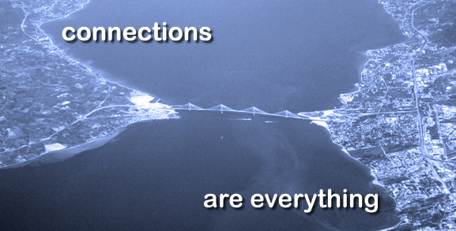
What have we learned?
Why is it important to activate our schema before we start to read?
When we activate our schema, we think of what we already know
Then, we use our background knowledge to make inferences
Notes:
‹#›

Slide 23
Building Your Schema
This is why it is so important to learn all that you can from what you read
The more you read, the more background knowledge you have
This will help you to learn even more from future texts
Notes:
‹#›

Slide 24
Your background knowledge is important!
Your background knowledge is very important
When you don’t have a schema for a topic, you will have a harder time understanding unfamiliar text.
Notes:
‹#›

Slide 25
by Emily Kissner & adapted by Rachel Shelly

