Slide 1
Commercial Buildings Energy Assessment Program
Training Module 2.2
Work, Power and Energy

Slide 2
Work, Power and Energy
Work : The effect created by a force when it moves a body.
Work = Force x Distance
Units: N-m (Joule)
ft-lb
Power: The time rate of doing work
Power = Work/Time
Units: Joule/sec or N-M/sec
Watt
Ft-lb/min
HP (33,000 Ft-lb/min = 1 HP)
HP and kW
1 HP = 0.746 kW

Slide 3
Power and Energy
Work : The effect created by a force when it moves a body.
Work = Force x Distance
Units: N-m (Joule)
ft-lb
Energy : The ability to do Work
Units: BTU (common basic unit for energy)
Power: Measures the rate of transferred energy
Units: Btu/hr (Btuh)
kW (Joule/sec)
HP

Slide 4
Energy and Work
What about Energy?
Energy is an abstract concept and difficult to define but it is often referred to as”
The ability to do WORK
Energy can be stored
Energy can be transferred
Also
Energy can represent WORK “W”
Energy can represent HEAT “Q”
BTU: British Thermal Unit
Energy unit used frequently to reference HEAT
1 BTU is the amount of heat energy required to raise the temperature of 1 lb of water by 1 degree F.
Calorie: The amount of heat energy required to raise the temperature of 1 kg of water by 1 degree C.

Slide 5
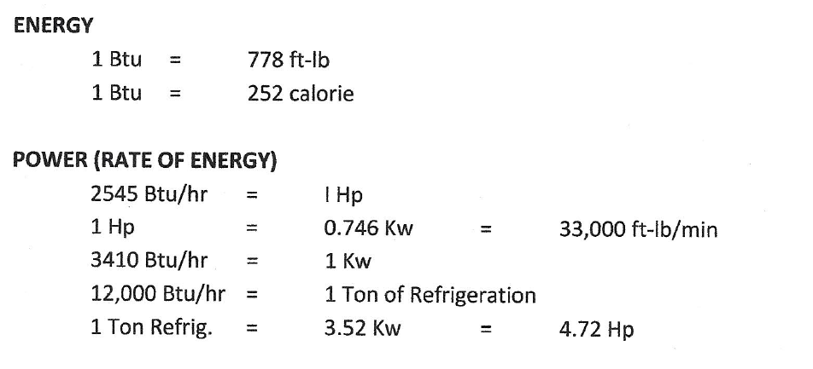
Power and Energy
Work : The effect created by a force when it moves a body.
Work = Force x Distance
Units: N-m (Joule)
ft-lb
Energy : The ability to do Work
Units: BTU (common basic unit for energy)
Power: Measures the rate of transferred energy
Units: Btu/hr (Btuh)
kW (Joule/sec)
HP

Slide 6
Power “Demand”
Power is also commonly referred to a DEMAND and LOAD
In building systems common Power Units are:
kW: Electrical use in utility bills also called the Demand
HP: Rate of energy use for Fans, Pumps, Compressors
Btu/hr: Rate of heat flow in heat loss and cooling load calculations
Tons of Refrigeration: Used common in air conditioning systems

Slide 7
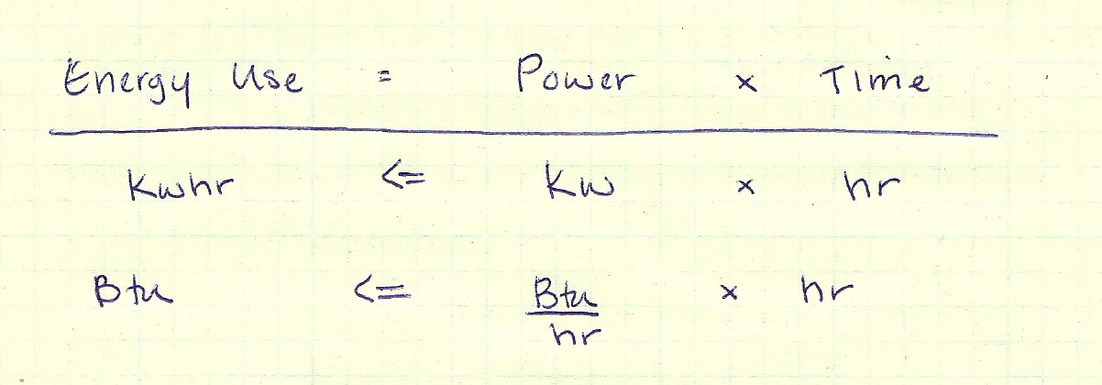
Energy Use
Energy Use
When you get an electric bill or natural gas bill, you are being charged for the energy used over a period of time. Electric utilities will send you a bill with a charge for kWh and natural gas is charged in Therms (or Btu). These are Energy Units, or energy consumed during the billing period.

Slide 8
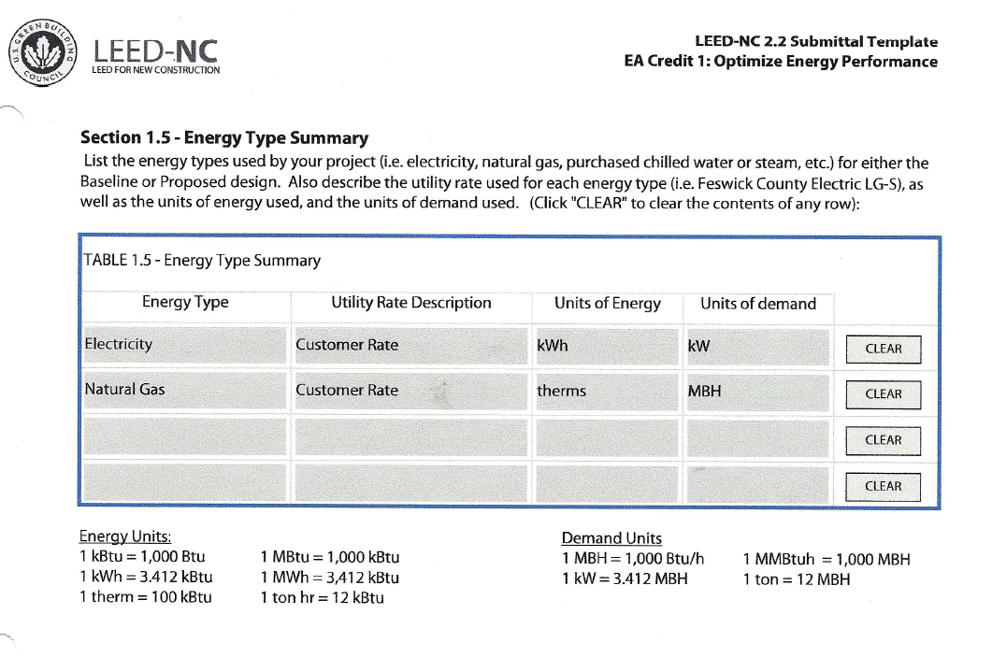
Energy Units and Demand Units

