Slide 1
Commercial Buildings Energy Assessment Program
Training Module 2.1
Physical Properties and Pressure

Slide 2
Physical Properties
Mass : The mass of an object is the quantity of matter it contains.
Units: kg
lb
Force : The push or pull that one body exerts on another
Units: N
lb
Weight : The force exerted on a body by the gravitational pull of the earth
Units: lb
Density : The mass per unit of volume
Units: kg/l
lb/ft^3
Specific volume: Volume per unit of mass
Units: l/kg
ft^3/lb

Slide 3
Pressure
Pressure = Force per unit of Area
Pascal = N/m^2
1 Bar = 100 kPa
P = F/A
P = lb/sq ft (psf)
P = lb/sq in (psi)
In Hg
Ft (w)
In. WC

Slide 4
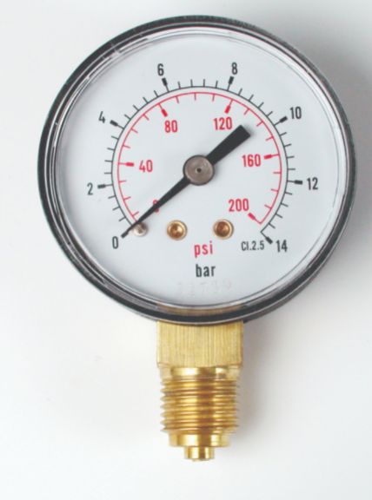
Absolute, Gage and Atmospheric Pressure
“measured” Pressure
P(abs) = P(atm ) + P(gage)
P (gage)
Atmosheric Pressure
P (vav)
P (abs)
P (atm)
Pressure measured relative zero pressure
“measured” Pressure
P (abs)
Zero Pressure
P(abs) = P(atm ) - P(vav)

Slide 5
Pressure and a Column of Liquid
Density of the fluid (more dense = greater pressure)
Height of the column
Pressure = Density x Height
Density lb/ft^3
Height ft
Then lb/ft^3 x ft = lb/ft^2 (or psf)
We could also convert this to lb/sq inch or psi using simple conversion factors.

Slide 6
“Head” Pressure
The term “head” pressure is used in plumbing and hydronic systems where the fluid measured is water.
1 psi = 1 lb/sq inch
P = density x height
P = 1 lb/sq inch or 144 lb/ft^3
Density = 62.4 lb/ft^3
Pressure = Density x Height can be written as Height = Pressure/Density
Substituting numbers and units:
Height(ft) = 144 lb/ft^2
62.4 lb/ft^3
1 psi = 2.3 ft (water)

Slide 7
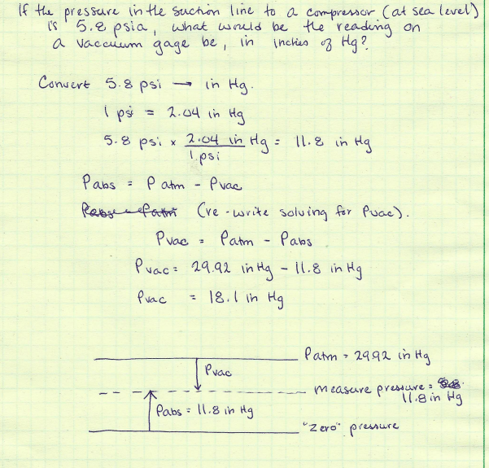
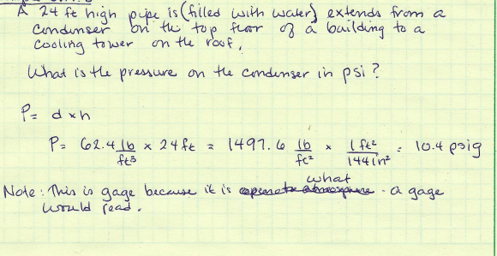
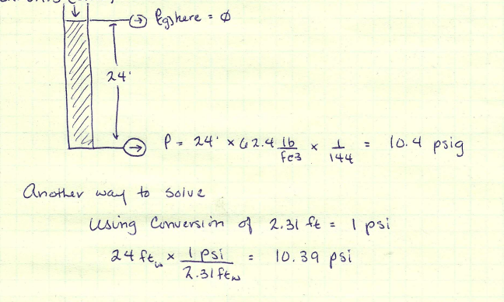
Example Problems

