Slide 1
Welcome to Airframe 02 AV279-2
Instructor: Jeff Erwin

Slide 2
Course Introduction
Sign-in
Syllabus
Calendar
Labs and readings
Course objectives

Slide 3
Hydraulics principles and history
The Greek word 'Hydra' refers to water while 'Aulos' means pipes.
Pascal’s law
In 1795 Joseph Bramah, developed an apparatus based on Pascal's law, known as Bramah's press.
Hydraulics became popular during the industrial revolution in 1850 in Britain

Slide 4
Theory
What are the advantages of using hydraulic systems?
Light weight
Ease of installation
Simple system
Minimum maintenance
Close to 100% efficient
Flexibility
Control
Cost

Slide 5
Aircraft uses
Landing gear
Wing flaps
Speed brakes
Wheel brakes
Flight controls

Slide 6
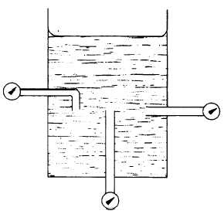
Science of Hydraulics
Hydrodynamics~science of moving liquid
Hydrostatics~science of liquids under pressure
Pascal’s law is expressed as follows: Pressure applied on a confined fluid at rest is transmitted undiminished in all directions and acts with equal force on equal areas and at right angles to them.

Slide 7
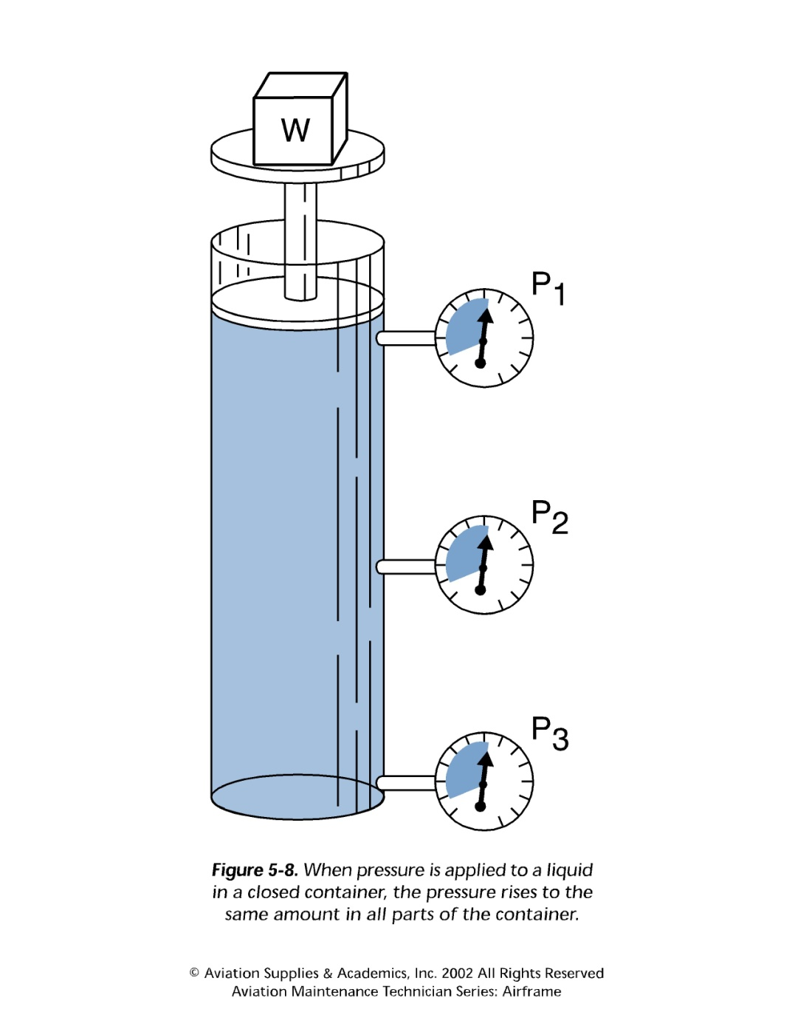

Slide 8
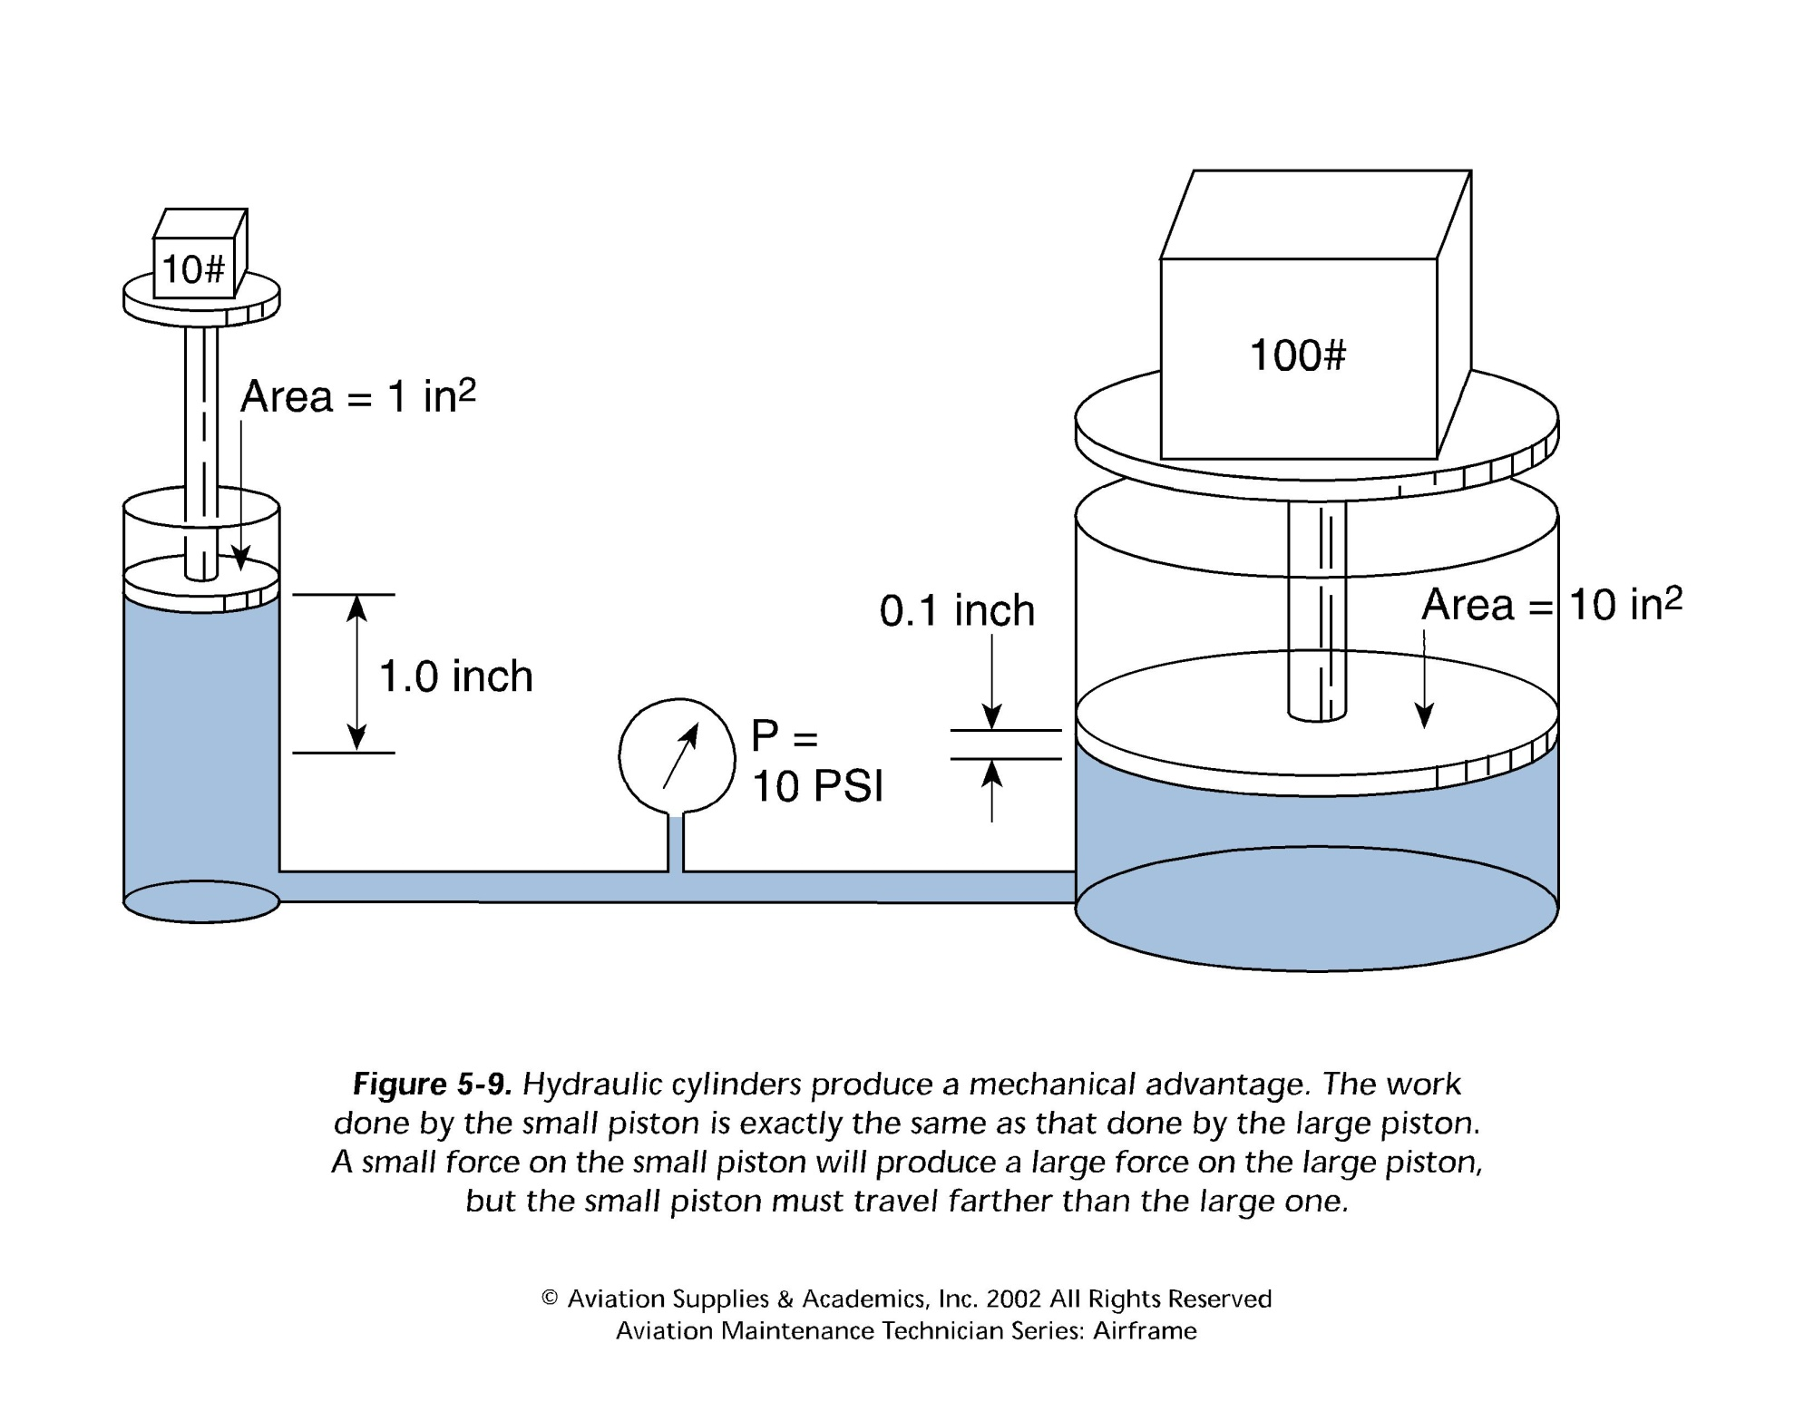

Slide 9
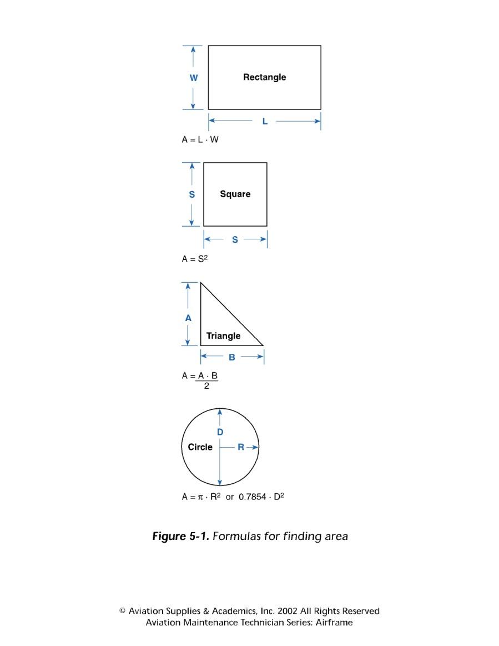
Physics review
Area calculations

Slide 10
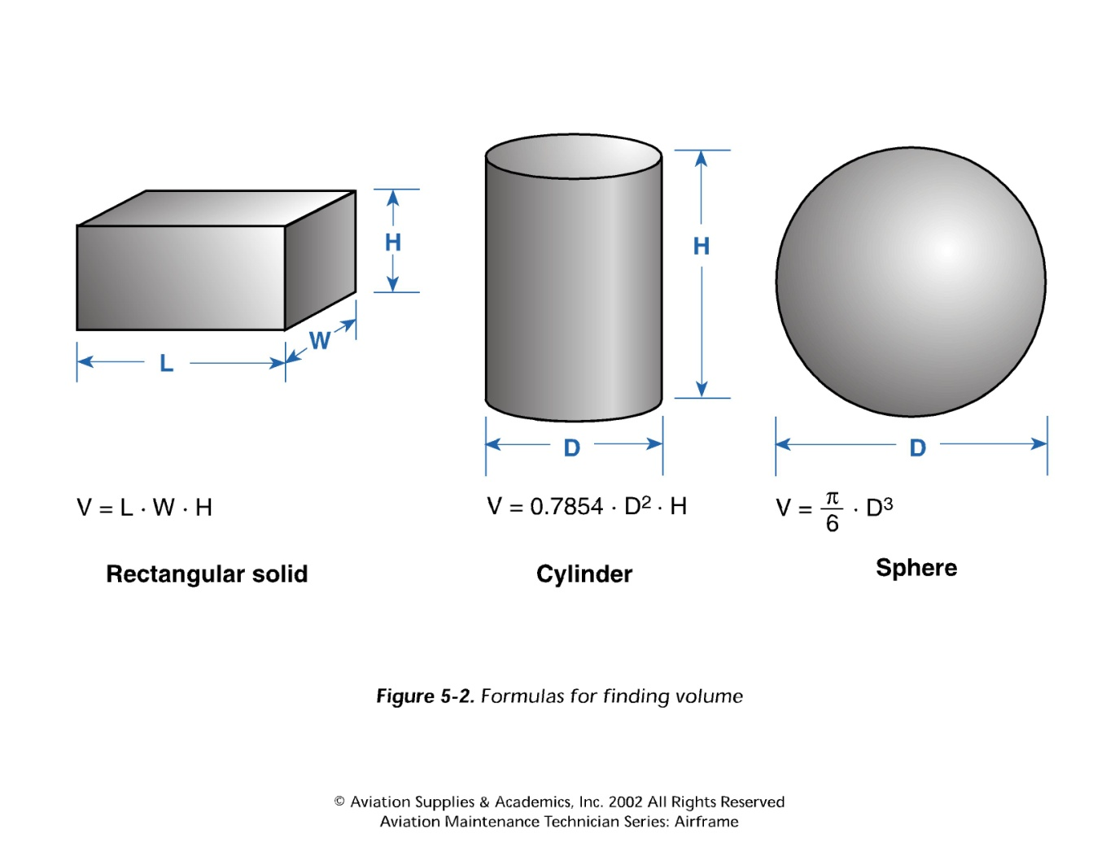
Physics
Volume

Slide 11
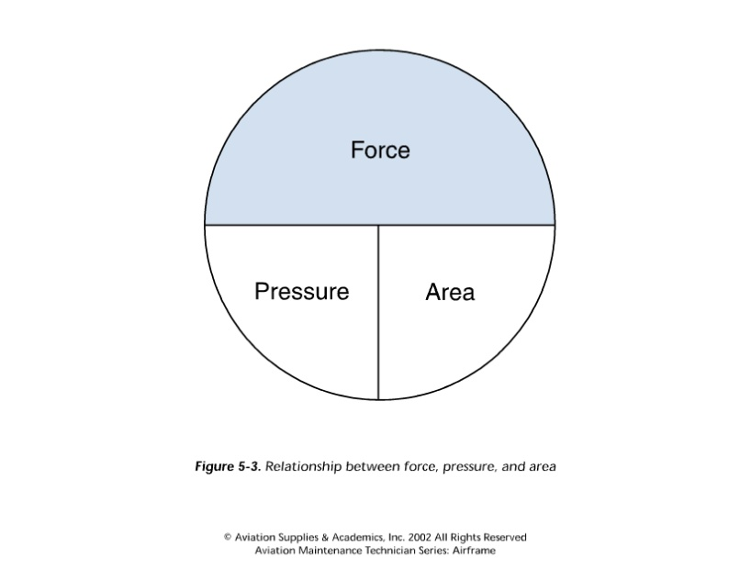
Physics
Force is energy brought on an object causing motion
Pressure is the energy which produces force
Area is the measurement of a surface

Slide 12
Exercise
A 1000psi hydraulic system, acting on a piston with an area of 0.5 square inches, will produce what amount of force?

Slide 13
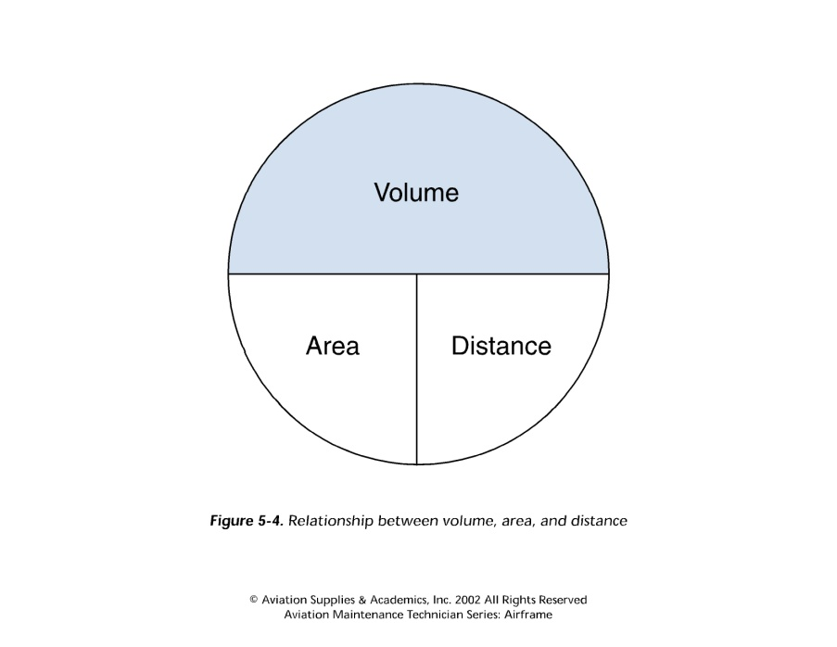
Physics
Volume is the space inside an object
Area is the measure of a surface
Distance is the amount of movement

Slide 14
Exercise
When a piston with an area of 20 inches is moved into a cylinder for a distance of five inches how much fluid will be displaced?
Notes:
A*d=100

Slide 15
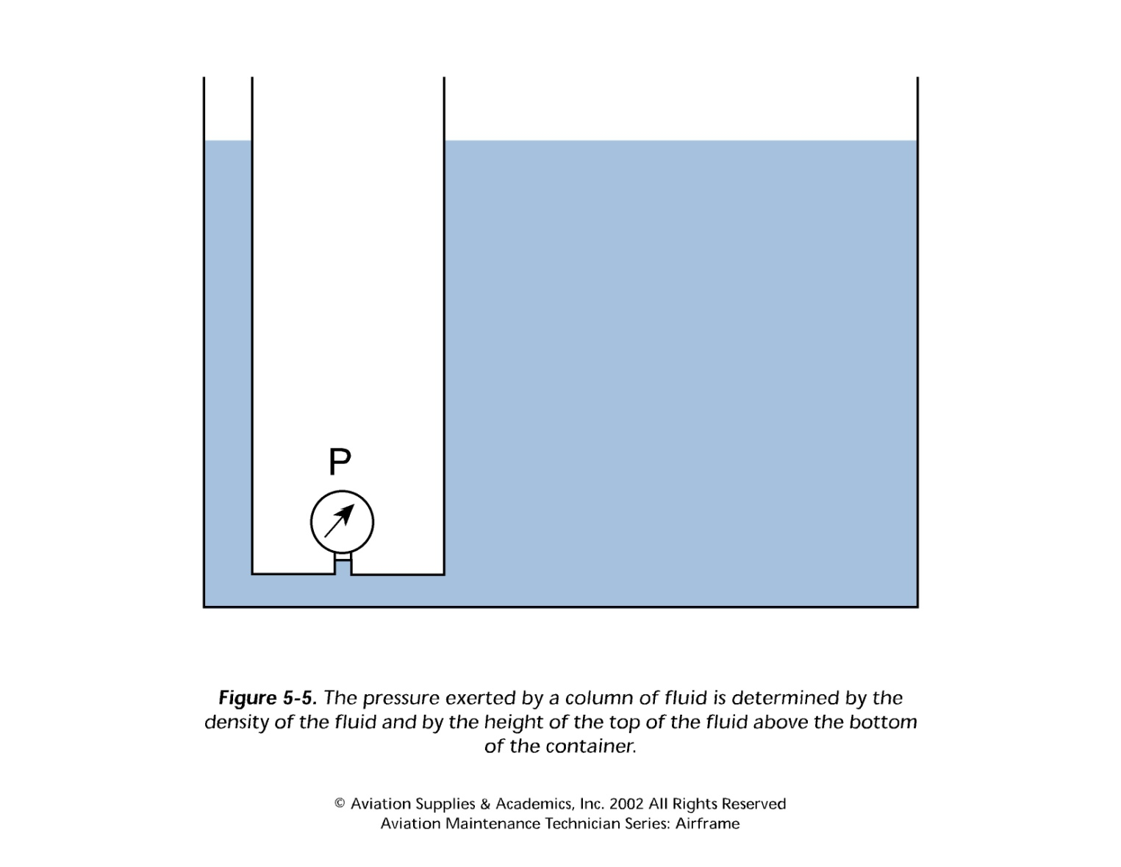
Height/Pressure relationship

Slide 16
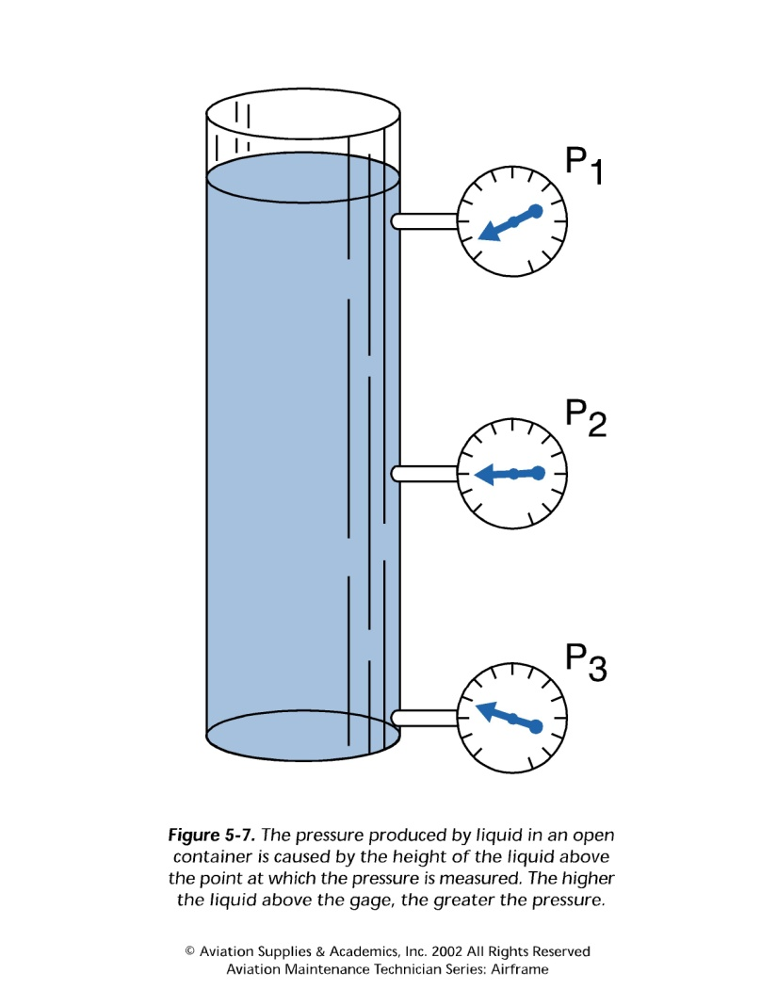
Open and closed systems

Slide 17
Mechanical advantage

Slide 18
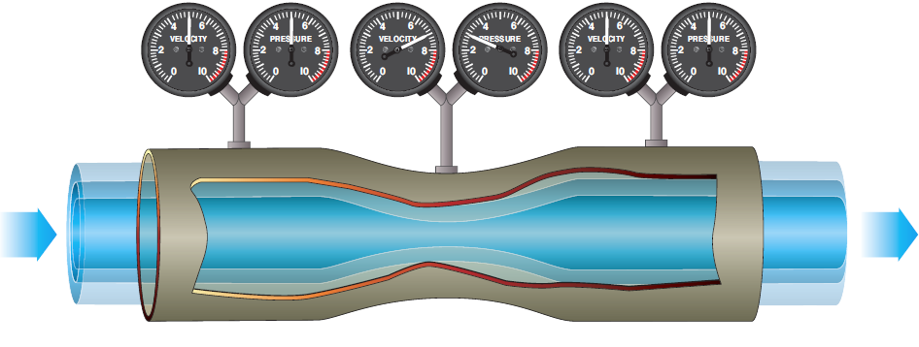
Fluid in motion
Bernoulli’s principle is my terms is: the total energy in a column of moving fluid remains constant, any change in velocity effects the pressure.

Slide 19
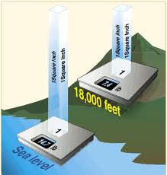
Fluids
Gas is a highly compressible fluid. (Pneumatics)
Atmospheric pressure
14.7psi at sea level
Liquid is a non-compressible fluid. (Hydraulics)

Slide 20
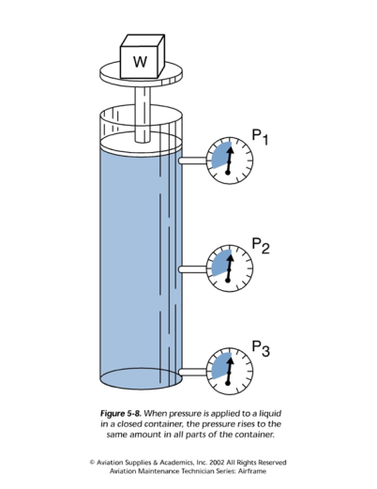
Pressure
Pressure – the force exerted against a specific area or force per unit area
Static pressure – the weight of the fluid itself
Shape and size does not matter
Height does matter
Mechanical pressure – the force exerted by pushing or squeezing a fluid.
Hydraulic lever
Hydraulic pump

Slide 21
Flow
Flow – the movement of a fluid caused by a difference in pressure at two points
Measured in two ways;
Velocity (fps)
Volume (gpm)

Slide 22
Review
Advantages of hydraulic systems in aircraft
Physics (Pascal’s Law)
Characteristics of fluids (Gas and liquid)
Relationship between force, area, and power
Relationship between volume, area, and length
Start your lab for today!

Slide 23
Reading assignments
FAA-H-8083-31, CH12 12.2-12.6
AC 43.13-1B, Pages 9-13 thru 9-15

