Slide 1
Commercial Buildings Energy Assessment Program
Training Module 1.4
Benchmarking

Slide 2
Benchmarking
Measure and compare a building’s energy to similar buildings, past energy consumption or as a reference to performance level.
Benchmarking allows you to
Compare a building to a national sample of similar buildings
Compare buildings of a similar type to each other
Identify and track individual building performance over time.

Slide 3
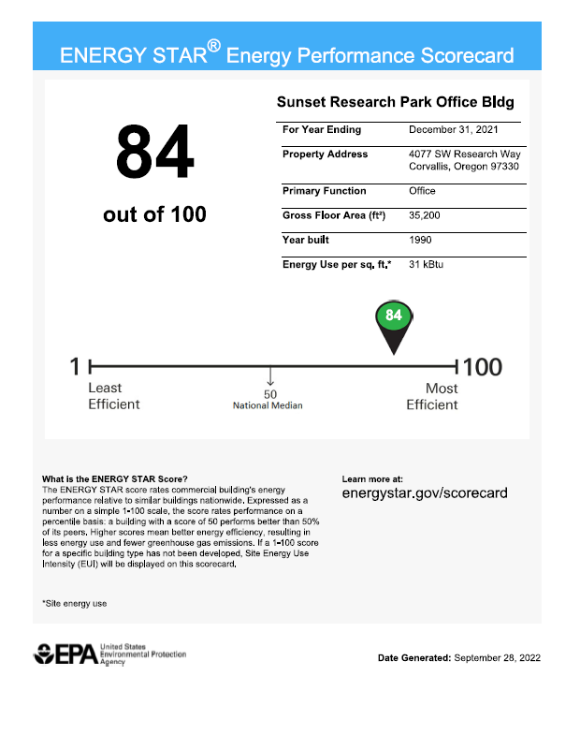
Energy Star Portfolio Manager
ENERGY STAR Portfolio Manager is an online resource management tool the benchmarks the energy use of any type of building.
Through the Portfolio Manager a building’s energy performance is evaluated, normalized for weather and compared to similar buildings nationwide. The building receives a score between 1-100. A score of 50 represents the median average.

Slide 4
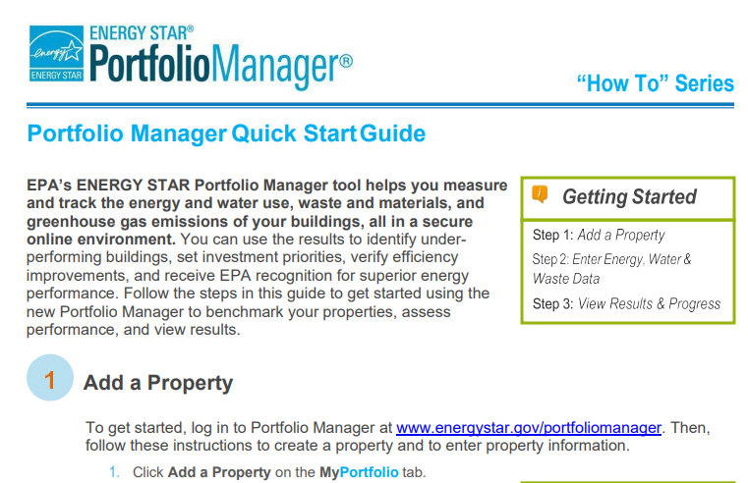
Energy Star Portfolio Manager
Getting Started:
All the information you need can be found on line at:
https://www.energystar.gov/buildings/benchmark/get_started
Here are the steps in benchmarkng the building:
Collect Data (The website has downloadable data collection forms for different types of facilities)
Name
Address
Gross Floor Area
Irrigated Area (if applicable)
Year Building
Occupancy
12 months of energy data
See the ENERG STAR Portfolio Manager Quick Start Guide on Moodle.

Slide 5
Energy Star Additional Resources
Training videos and additional resources can be found on the Energy Star Website:
https://www.energystar.gov/buildings/training

