Slide 1
Commercial Buildings Energy Assessment Program
Training Module 1.5
Utility Data

Slide 2
Preliminary Energy Use Analysis
Determine the building’s gross conditioned area. Exclude unconditioned areas such as walk-ways, covered porches, areas under overhangs, etc.
Assemble copies of the utility bills, at least one full year. Multiple years may be useful for establishing trends and looking for significant changes.
Complete the energy summary to develop and EUI and ECI. Use Energy Star Portfolio Manager to benchmark the building. (See Training Module 1.4 – Benchmarking).

Slide 3
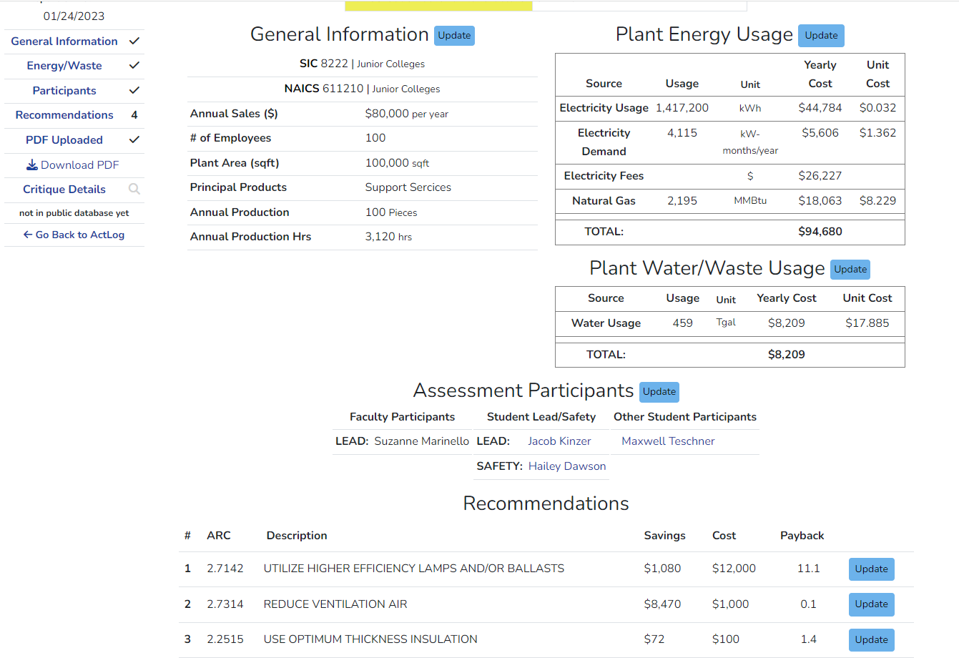
IAC Data Entry

Slide 4
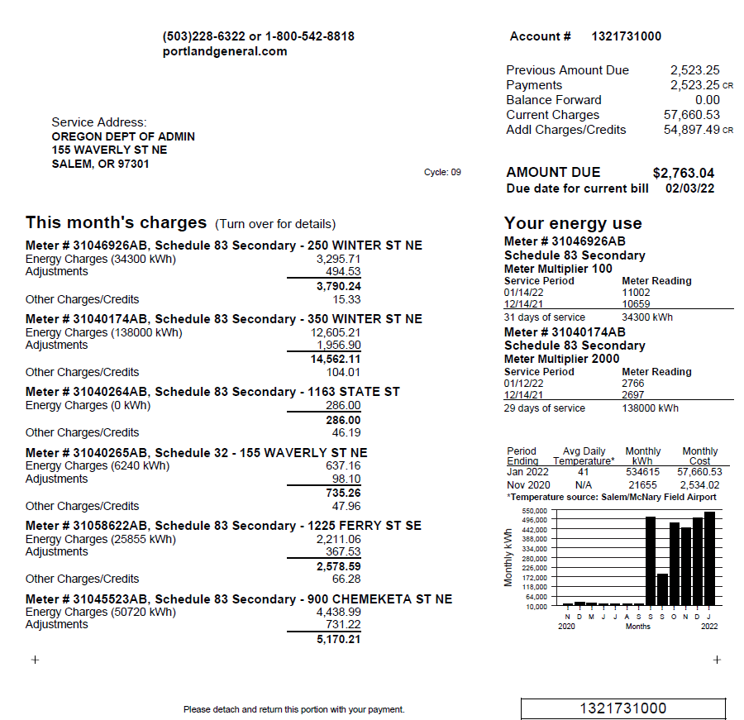
Electrical Bills – Real Life Example

Slide 5
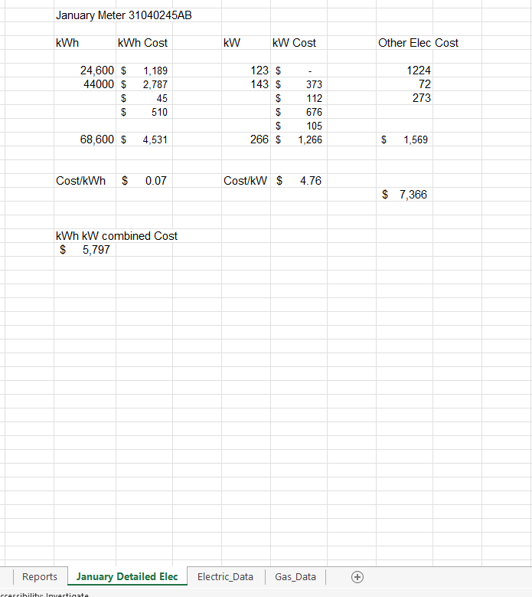
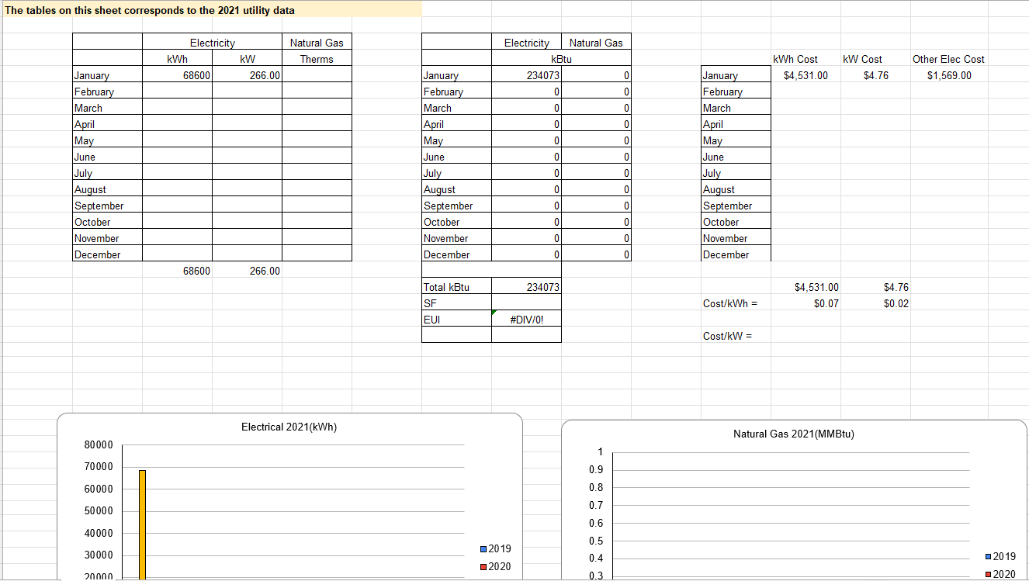
Developing Spreadsheets - Electrical

Slide 6
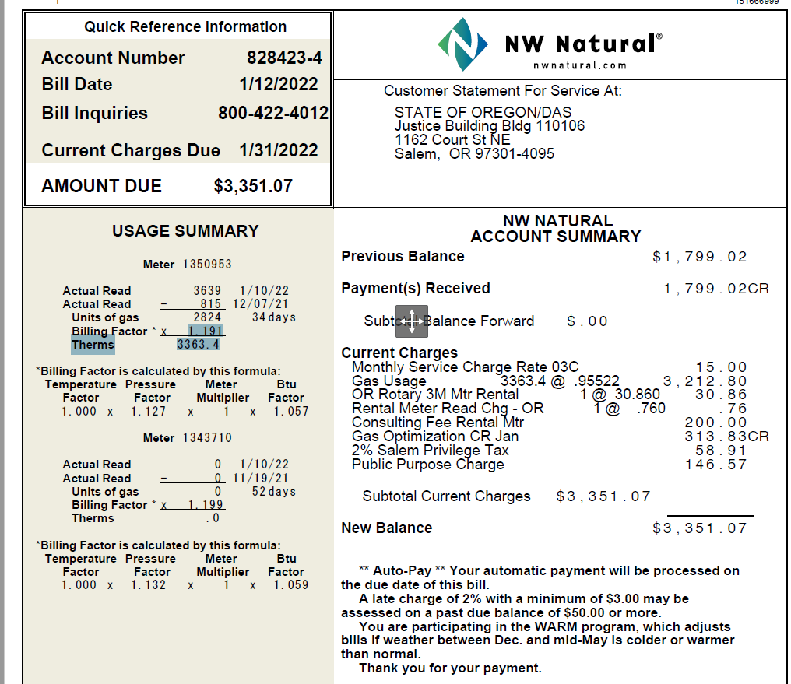
Natural Gas Bills – Real Life Example

