Slide 1
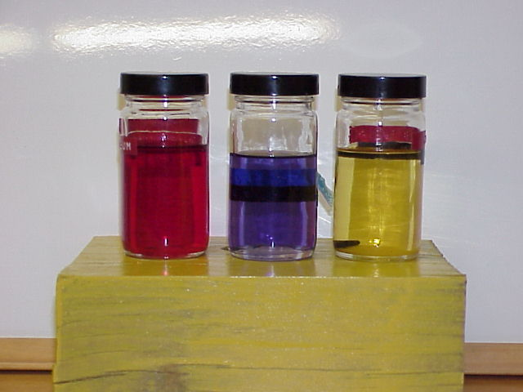
Aviation Hydraulic Fluids
Presented By: Jeff Erwin

Slide 2
Objectives
History of hydraulic fluid
Hydraulic fluid properties
Basic types of hydraulic fluid
Servicing and safe handling techniques

Slide 3
History of Aviation Hydraulic Fluid
Early aviation hydraulics systems used vegetable based fluid to apply brake pressure.
Aircraft advancements prompted creation of mineral based fluids.
High rates of hydraulic system fires led to creation of the fire-resistant fluids.
Notes:
As aircraft performance increased in mid-20th century, the amount of force required to operate mechanical flight controls became excessive, and hydraulic systems were introduced to reduce pilot effort.

Slide 4
Purpose of Hydraulic Fluid
Primary purpose is to convey power
Lubricate and cool
Corrosion protection
Notes:
Ability to transfer power in different directions

Slide 5
Properties of Hydraulic Fluid
Low compressibility
Low viscosity for ease of movement and filterability
Stable over a wide temperature range
Notes:
What is one of the most important qualities of hydraulic fluid?

Slide 6
Basic Hydraulic Fluids
Vegetable based fluid MIL-H-7644
Mineral based fluid MIL-H-5606
Polyalphaolefins/Synthetic hydrocarbon based MIL-H-83282 /87257
Phosphate Ester based hydraulic fluid MIL-H-8446. Trade names are SKYDROL or EXXON HYJET
Notes:
Used in brake systems on older aircraft with natural rubber seals.
Mil-H-5606-used in smaller type aircraft.
MIL-H-83282- higher flashpoint, self-extinguishing, backward compatible, Mil-H-87257: A development of -83282 fluid to improve its low temperature viscosity.
Various version improving performance and safe handling charactoristics
Phosphate Ester based fluid is used in mostly in commercial transport aircraft and has evolved with aircraft performance demands in the form of types

Slide 7
Vegetable Based Characteristics
Composed of castor oil and alcohol
Dyed blue
Easily recognized odor
Only used with natural rubber seals
Can produce sludge and corrosion
Notes:
Now used mostly in older aircraft or more commonly in automobiles
Can absorb water

Slide 8
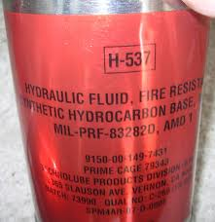
Mineral / Hydrocarbon Based Characteristics
Mineral Oil/ Polyalphaolefins
Dyed red
Distinct odor
Stable in colder weather
Contains foaming and corrosion inhibitors
Must be used with synthetic seals only
Is highly flammable in the MIL-H-5606 form
MIL-H-83282 is a fire-resistant version, but has a higher viscosity in cold weather
Notes:
5606 and 83282 can be mixed, but will lose some of the fire-resistant qualities
Flashpoint of MIL-H-5606 is 275 F limited to -65 f
Flashpoint of MIL-H-83282 is 400 f limited to -40 f

Slide 9
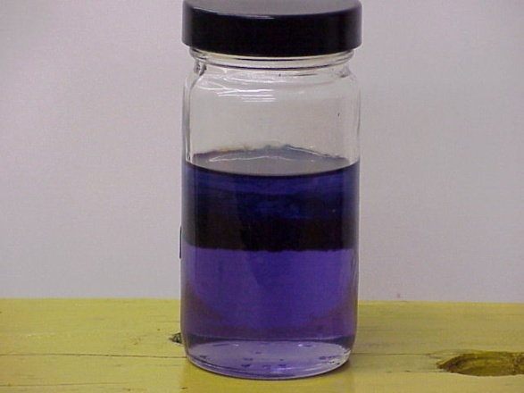
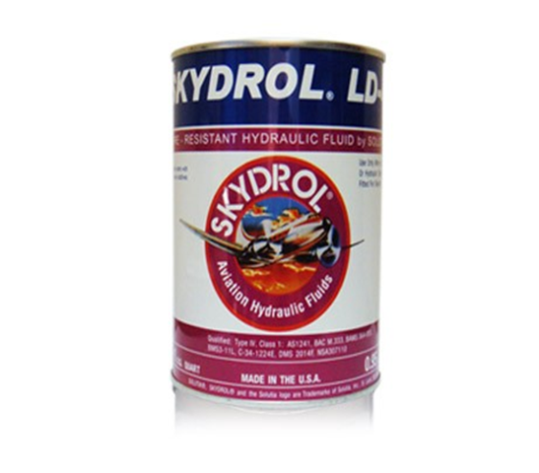
Phosphate Ester Characteristics
Synthetic (man-made) fluid
Dyed Purple
Extremely fire resistant
Wide temperature operating range
Attracts water
Attacks certain paints and plastics
Can degrade aircraft wiring insulation
Material compatibilities www.skydrol.com/pages/materials_chart.asp
Notes:
Skydrol has evolved to accommodate advances in aircraft and is commonly identified by a type category

Slide 10
Handling of Hydraulic Fluids
Attention: Special, stringent care is required when handling aircraft hydraulic fluid as it is critical to flight safety that it stay free from contamination!
Always close containers
Keep storage area clean
Ensure servicing equipment is clean
Clean aircraft service ports before and after servicing
Properly dispose of used hydraulic fluid
Notes:
9-14

Slide 11
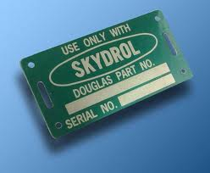
Basic Servicing
Always verify fluid type before servicing
Consult applicable maintenance manual (microfiche)
Observe placard located on servicing port

Slide 12
Hydraulic Fluid Safety
Vegetable & mineral based fluids safe to handle.
(Caution: avoid getting fluid in the eyes)
Phosphate Ester fluids require impervious gloves, eye protection, and respirator when mist or vapor exposure might occur.
Always consult appropriate MSDS before using hydraulic fluids.
http://www.skydrol.com/pages/ppe.asp (Safety resource)
Notes:
9-15

Slide 13
Review
History of hydraulic fluids
Properties of hydraulic fluids
Three basic types of fluids and their characteristics
Servicing and handling techniques
Fluid Safety

Slide 14
Questions?

